Slide 1

Module 2
Data Types, Variables, and Constants
Lab exercise and Assignment Introduction

Slide 2
Content
Decimals/ Characters/ Booleans
Operations
Choosing Between Variables and Constants
Giving Variables a Value
Type Conversions
What About Reference Types?
Putting It All Together in a Console App
Putting It All Together in a Unity Script
Common Mistakes

Slide 3
Decimals
The floating point data types could not handle all our real number needs.
Because everything in a computer is stored using a limited number of bits, the computer works in the discrete domain.
Let's talk about the double data type
a double is stored in 64 bits, so the total number of unique values that we can store in a double is 2^64, which is about 1.8 * 10^19 ➔ it's not infinite.
That means that we have to approximate lots of those infinite numbers in the real world with a single sequence of bits in the computer, making them indistinguishable from each other.
We can't get perfect precision with our floating point data types.

Slide 4
Decimals
Think about a program that runs a cash register. That program needs to be able to precisely store dollars and cents.
Allowing imprecision in the variables we use won't be acceptable.
The decimal type helps solve that problem.
The 128 bits used for the decimal type can more precisely represent the possible values in its range
range from -79,228,162,514,264,337,593,543,950,335 to 79,228,162,514,264,337,593,543,950,335.
stores up to 28 decimal places.

Slide 5

Decimals
Example:
The valid operations for decimal: +, -, *, and /
The tradeoff we make between decimal and the floating point types is that decimal gives us more precise numbers in a smaller range.
the best choice for some domains, like cash register software, but
a worse choice for other domains, like quantum physics
By considering what range of numbers your program needs to store and with what precision, you can make a reasoned choice about which data type to use.

Slide 6

Characters
A variable or constant declared as a char (short for character) can hold a single 16-bit Unicode character.
A character can be a letter, a digit, a space, a punctuation mark, or other characters.
Example:

Slide 7
Read yourself
Booleans
Operations
Choosing Between Variables and Constants
Giving Variables a Value
Type Conversions
What About Reference Types?

Slide 8
Putting It All Together in a Console App
The problem description:
Calculate the area of the circles with integer radii from 0 to 5, then print out the radius and area for each circle.
Understand the Problem:
“from 0 to 5” includes 0 and 5
Design a Solution:
The Main method in our Program class.

Slide 9
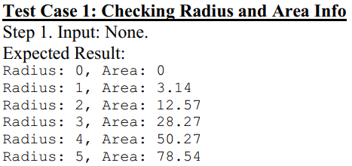
Putting It All Together in a Console App
Write Test Cases:
All we have to do is run it to make sure it prints out the required circle info.

Slide 10
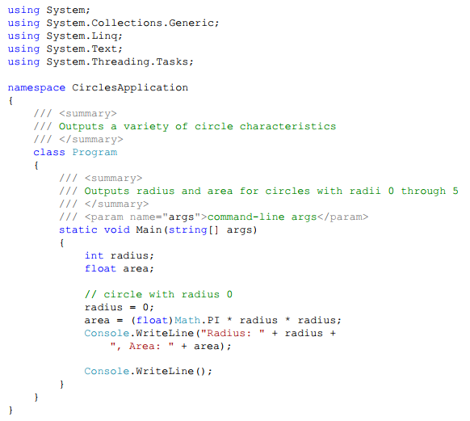
Putting It All Together in a Console App
Write the Code

Slide 11
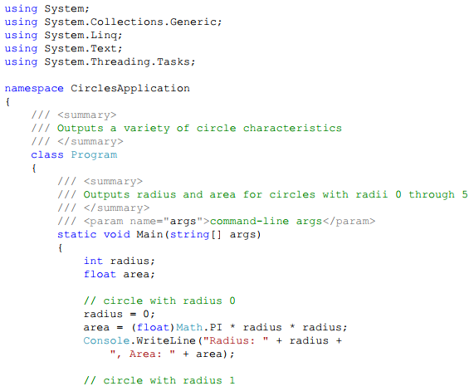
Putting It All Together in a Console App
Write the Code

Slide 12
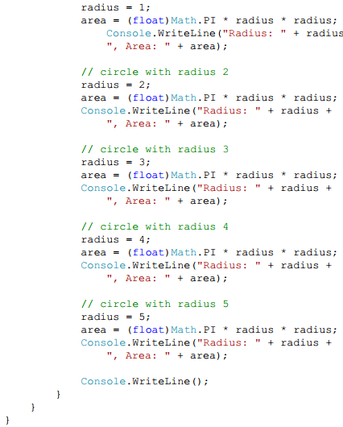
Putting It All Together in a Console App
Write the Code

Slide 13
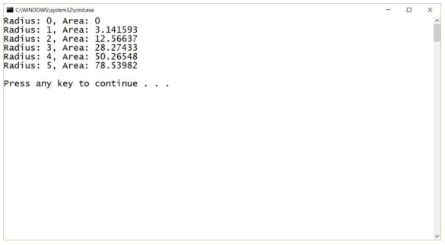
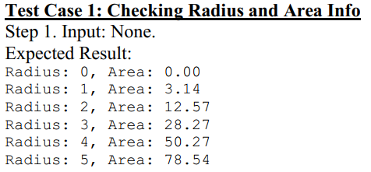
Putting It All Together in a Console App
Test the Code

Slide 14
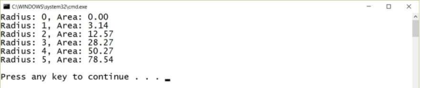
Putting It All Together in a Console App
Change the way we call the method to make formatting the output a little easier:
Changes the {1} to {1:N2}:
Output

Slide 15
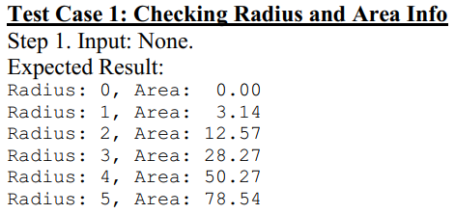
Putting It All Together in a Console App
If we’re going to change the way we expect the code to behave, we need to change the test case to reflect the new behavior:

Slide 16
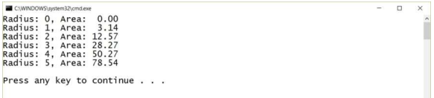
Putting It All Together in a Console App
Our final change to the first call on the Console.WriteLine method is
Final output:

Slide 17
Putting It All Together in a Unity Script
Let's solve essentially the same problem we solved in the previous section in Unity using the same problem description:
Calculate the area of the circles with integer radii from 0 to 5, then print out the radius and area for each circle.
Understand the Problem
Provide our output in the Console window in the Unity editor.
Design a Solution
Write a new PrintCircleInformation script and implement the required functionality in the Start method in that script.

Slide 18
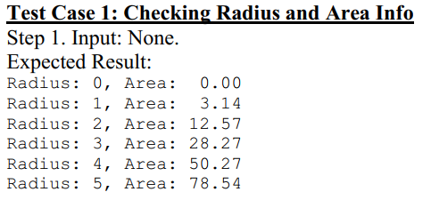
Putting It All Together in a Unity Script
Write Test Cases

Slide 19
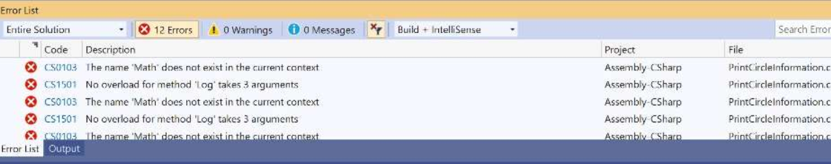
Putting It All Together in a Unity Script
Write the Code
Copy the code from the Main method in our console app into the Start method in our new script and change all the calls to the Console.WriteLine method to calls to the Debug Log method instead.
Unity provides a Mathf class that provides functionality similar to C#’s Math class, but with floats not doubles. Change (float)Math.PI to Mathf.PI

Slide 20
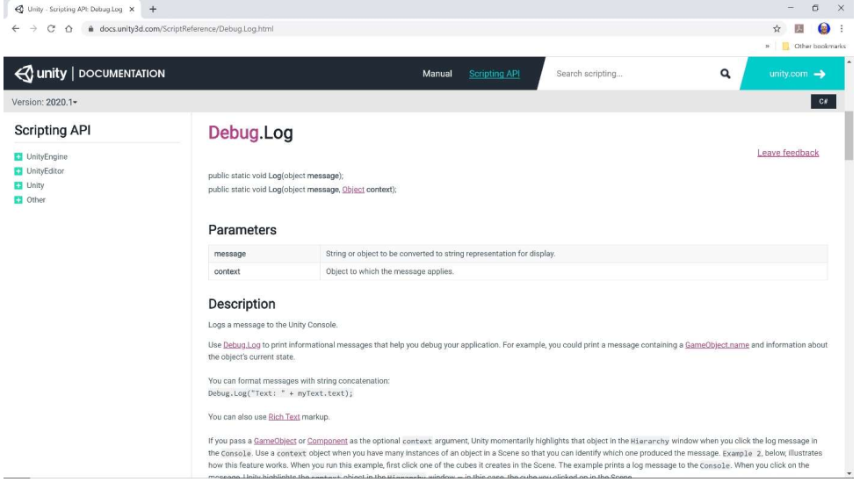
Putting It All Together in a Unity Script
Write the Code
The Debug Log method is provided in Unity, not in standard C#, so we should search the Unity Scripting Reference for that method.

Slide 21
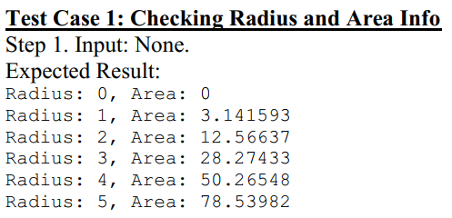
Putting It All Together in a Unity Script
Write Test Cases, Revisited
Write the Code, Revisited
Change our calls to the Debug Log method back to our original approach using concatenation instead of formatting.

Slide 22
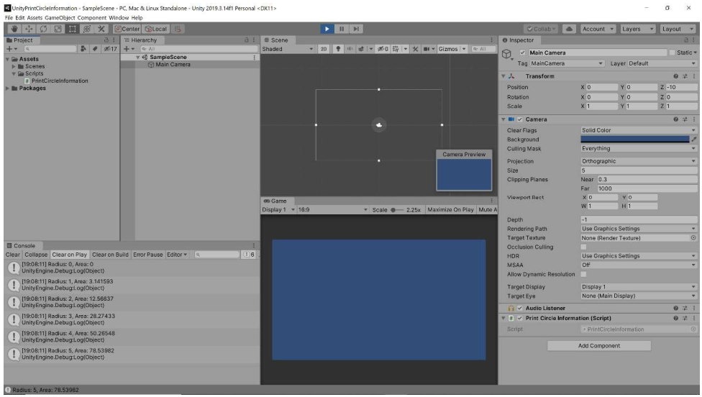
Putting It All Together in a Unity Script
Test the Code

Slide 23
Common Mistakes
Forgetting that C# is Case Sensitive
a variable named firstInitial is NOT the same as a variable named firstinitial
Forgetting How Integer Division Works
when you divide two integers, you get the integer quotient, not a floating point result from the division.
If you do need a floating point result from dividing two integers, you can simply use type casting as described above.

Slide 24
Summary
Value Types, Variables, and Constants
Integers/ Floating Point Numbers/ Decimals/ Characters/ Booleans
Operations
Type Conversions
Reference Types

